Slide 1
Peace Corps Commemorative Foundation
Building a memorial honoring the preeminent, historic and lasting significance of the establishment of the Peace Corps and the American ideals and values inherent in Peace Corps service
Selecting a Commemorative Site:
Criteria, Evaluation, Preferences
Preliminary Study Report prepared by the PCCF for the
National Capital Memorial Advisory Commission
May 6, 2014

Slide 2
Peace Corps Commemorative Foundation
OFFICERS and BOARD of DIRECTORS
Roger K. Lewis, FAIA (RPCV, Tunisia 1964-66)
Architect & Planner, Professor Emeritus of Architecture, University of Maryland
President and Chairman
Bonnie S. Gottlieb, Esq. (RPCV, Ivory Coast 1972-74)
Senior Vice President, Industry & Member Affairs, National Association of Real Estate Investment Trusts
Vice President & Secretary-Treasurer
Gordon Radley (RPCV, Malawi 1968-70)
Former President, Lucasfilm Ltd.
Tony Barclay, PhD (RPCV, Kenya 1968-70)
Chairman, National Peace Corps Association
Eleanor R. Lewis, Esq.
Former Chief Counsel for International Commerce, U.S. Department of Commerce

Slide 3
Why the Peace Corps Commemorative in the heart of Washington, DC
America’s Most Eminent Historians Eloquently and Convincingly Answer this Question
Doris Kearns Goodwin, Pulitzer Prize winning historian
“President John F. Kennedy’s founding of the Peace Corps in 1961 is an event in American history of profound and lasting significance, both nationally and internationally, and it deserves permanent commemoration in the nation’s capital…Merging idealism and realism, the Peace Corps was to represent America by embodying and expressing, through unselfish action, American’s humanitarian values and altruistic national character... the Peace Corps has produced an enduring American legacy of service in the cause of peace, a timeless symbol of America’s most honorable ideals and aspirations.”
Elizabeth Cobbs Hoffman, Dwight Stanford Chair of U.S. and Foreign Relations, San Diego State University
“At the apex of American wealth and power during the Cold War, concerned politicians of both parties called for government to define what the nation stood for, not just what it stood against, in the ‘American Century.’ The establishment of the Peace Corps marked a critical moment when, for the first time, the U.S. government appealed to its citizens to serve their country in the cause of international development and peace. The Peace Corps stretched the capacity of the nation to accept that others’ interests have a place in foreign policy, even if a small one. It challenged cynicism as naïve and allowed Americans to give practical expression to the finest ideals of the Declaration of Independence. In doing so, it demonstrated to the world and to Americans alike that self-interest and service to others are not mutually exclusive. The Peace Corps gave expression to a fundamental American ideal, the idea that the power to do good is not inconsistent with geopolitical power even in the most difficult times.”
David M. Kennedy, Donald McLachlan Professor of History, Emeritus, Stanford University; Pulitzer Prize winning historian.
“The Peace Corps was a unique product of a unique moment in time, when American power was infused with idealism and purpose, and American foreign policy was guided by citizen engagement and citizen participation. The Peace Corps materially benefitted countless peoples in developing countries. Less measurably, but no less importantly, Peace Corps volunteers carried abroad – say rather, lived abroad – some of the republic’s highest and best aspirations for itself and for ‘all men in all lands’ as well.”
The Peace Corps Commemorative Foundation sought the perspectives of these historians to support Congressional authorization for the Peace Corps Commemorative. All are experts in United States history, and Elizabeth Cobbs Hoffman wrote a book about the Peace Corps in the 1960s. All three immediately confirmed - in the writings quoted above - the historic significance of establishment of the Peace Corps and enthusiastically endorsed creation of the Commemorative. Their written endorsements are not part of any of their published writings. None of the historians are Returned Peace Corps Volunteers, and no standing relationship exists between the historians and the PCCF or the Peace Corps.

Slide 4
Why the Peace Corps Commemorative Must Take Its Place In or Near the Monumental Core of the Nation’s Capital
As these eminent historians attest, the Peace Corps and Peace Corps service are a manifestation of core values, principles and aspirations expressed implicitly as well as explicitly in the Declaration of Independence and the Bill of Rights, and in the memorable words of Thomas Jefferson, Abraham Lincoln, Franklin D. Roosevelt, Martin Luther King, Jr., John F. Kennedy and other distinguished American leaders.
Indeed these fundamental American ideals and values motivated the historic establishment of the Peace Corps and thus merit commemoration in a prominent place in the nation’s capital near the Monumental Core’s other memorials and public spaces.
In our capital we have commemorated Presidents and key individuals who have shaped the American principles by which we live. We have remembered and honored the valor and sacrifice of those who have served our nation in times of war. These memorials embody America’s identity, values and experiences. Yet as inspiring as these memorials are, they give an incomplete picture of what we believe, how we see ourselves and our role in the world. Certain American ideals have yet to find an expressive voice in our capital landscape.
Our Monumental Core needs a commemorative destination where these American ideals and values can be honored as well, a national memorial that will inspire our youth and remind the world of some of the best qualities of what it means to be “an American.”

Slide 5
Peace Corps Commemorative
Site Location Considerations and Evaluation Criteria
The Peace Corps Commemorative will occupy a small site in the heart of Washington, DC. But to avoid trivializing the significance of the historic event and ideals being honored and celebrated, the Commemorative – while modest in size, scale and cost - requires a memorable location to achieve a sense of presence and gravitas among the many much larger memorials and monumental structures in the nation's capital.
No matter how well designed, the Commemorative cannot take its proper place in the capital if it is remote from the city’s heart or embedded within a commercial district or residential neighborhoods. To more fully express who we are as a people and enhance understanding of America’s core principles, the Peace Corps Commemorative should not be isolated from other memorials honoring these same principles, ideals and values within the Monumental Core.
Establishment of the Peace Corps and the ideals and values it represents are a quintessential, preeminent part of American history, and a vital part of world history. Peace Corps volunteers have lived with, helped and positively affected countries and cultures, local communities, and individuals worldwide. Because Peace Corps volunteers have touched so many lives, visitors from around the world, as well as visitors from all corners of our nation, will want to see and experience the evocative Peace Corps Commemorative. A visible and accessible site near "beaten paths" trod each year by millions will enable this to occur.
To fulfill the mission of the Commemorative, views from the site of surrounding streets and abutting properties must be attractive and inspiring and not detract or distract from the Commemorative message. Such views need to encompass landscapes and structures of national significance, not commercial properties. Situating the Peace Corps Commemorative near historically significant national landmarks will create a strong, meaningful “nexus,” linking Peace Corps ideals and values to those expressed throughout the capital’s Monumental Core.
The site must not be topographically difficult, oddly configured or encumbered by existing structures, trees or elaborate vegetation necessitating costly and potentially controversial removal or preservation.
The site must be transit-accessible and have access to adequate public parking.

Slide 6
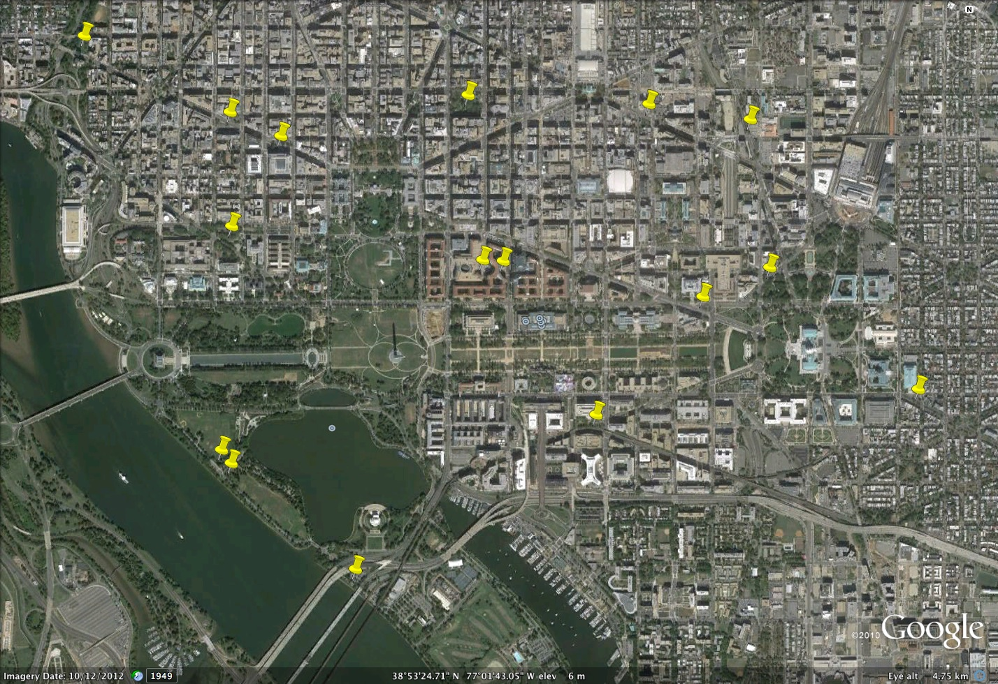
Plan view of Washington showing the many sites that the PCCF has looked at

Slide 7
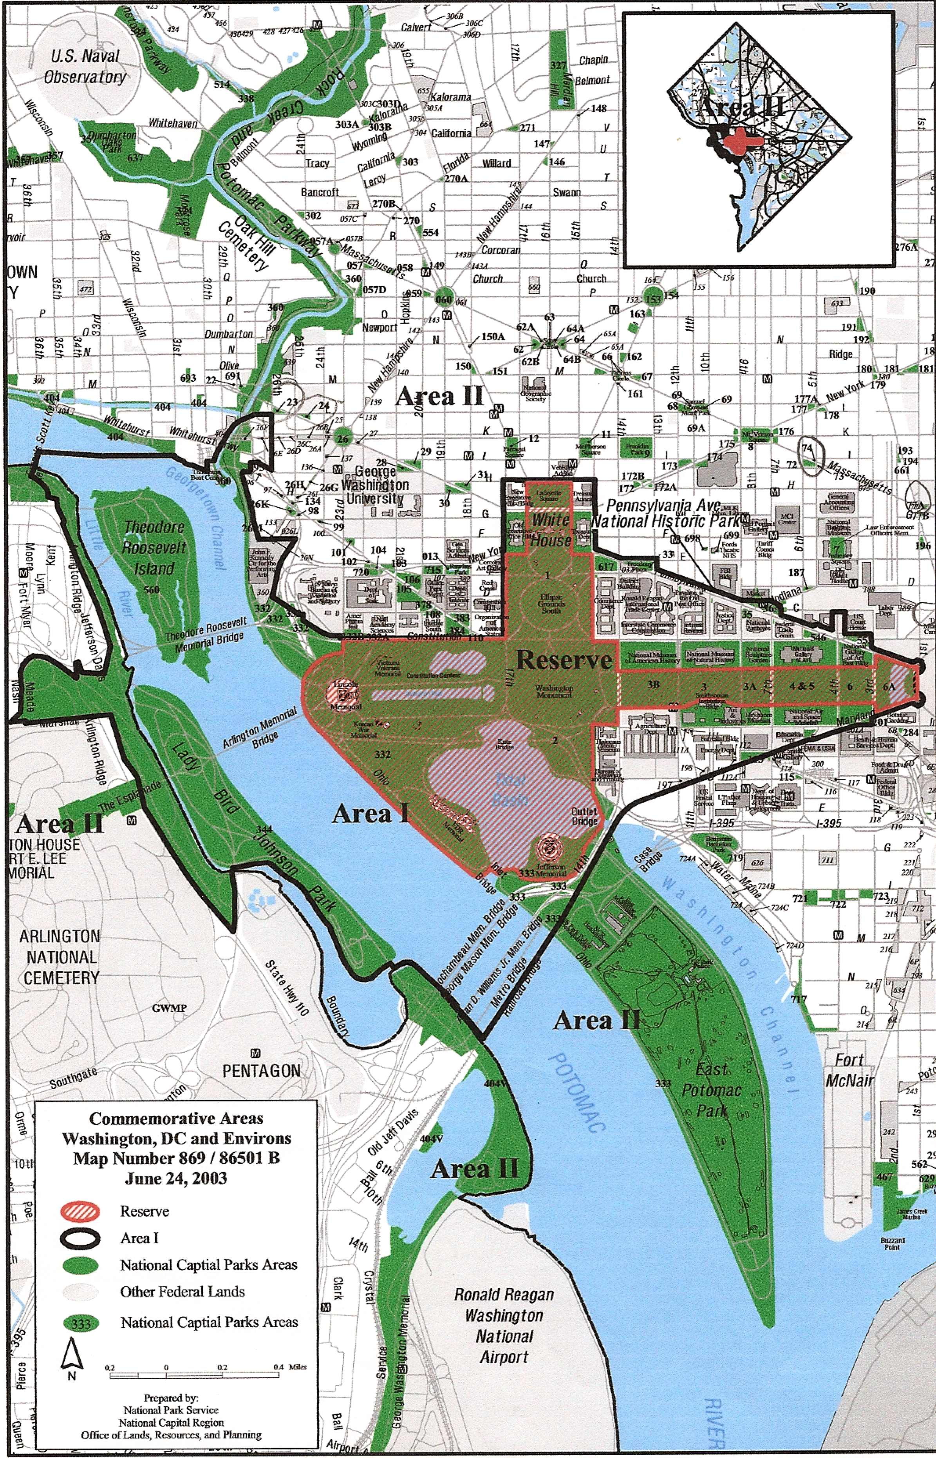
The PCCF considered most available sites unsuitable because they would distance the Peace Corps Commemorative from the national monuments and public spaces of the Monumental Core, isolating and undermining the message of the Commemorative: that establishment of the Peace Corps and the ideals and values of Peace Corps service are historically preeminent, convey who we are as a people, and merit commemoration alongside other significant national memorials embodying and expressing these same ideals and principles. Accordingly the following slides show the few sites we evaluated in detail.

Slide 8
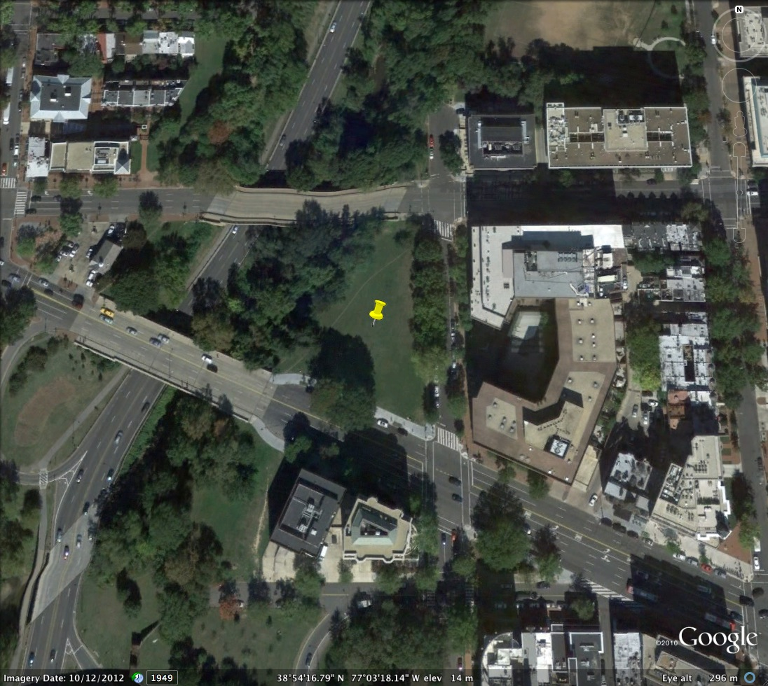
NCPC Site 46 – bounded by Rock Creek Park, Pennsylvania Avenue, 26th & M Streets, NW, at the eastern edge of historic Georgetown

Slide 9
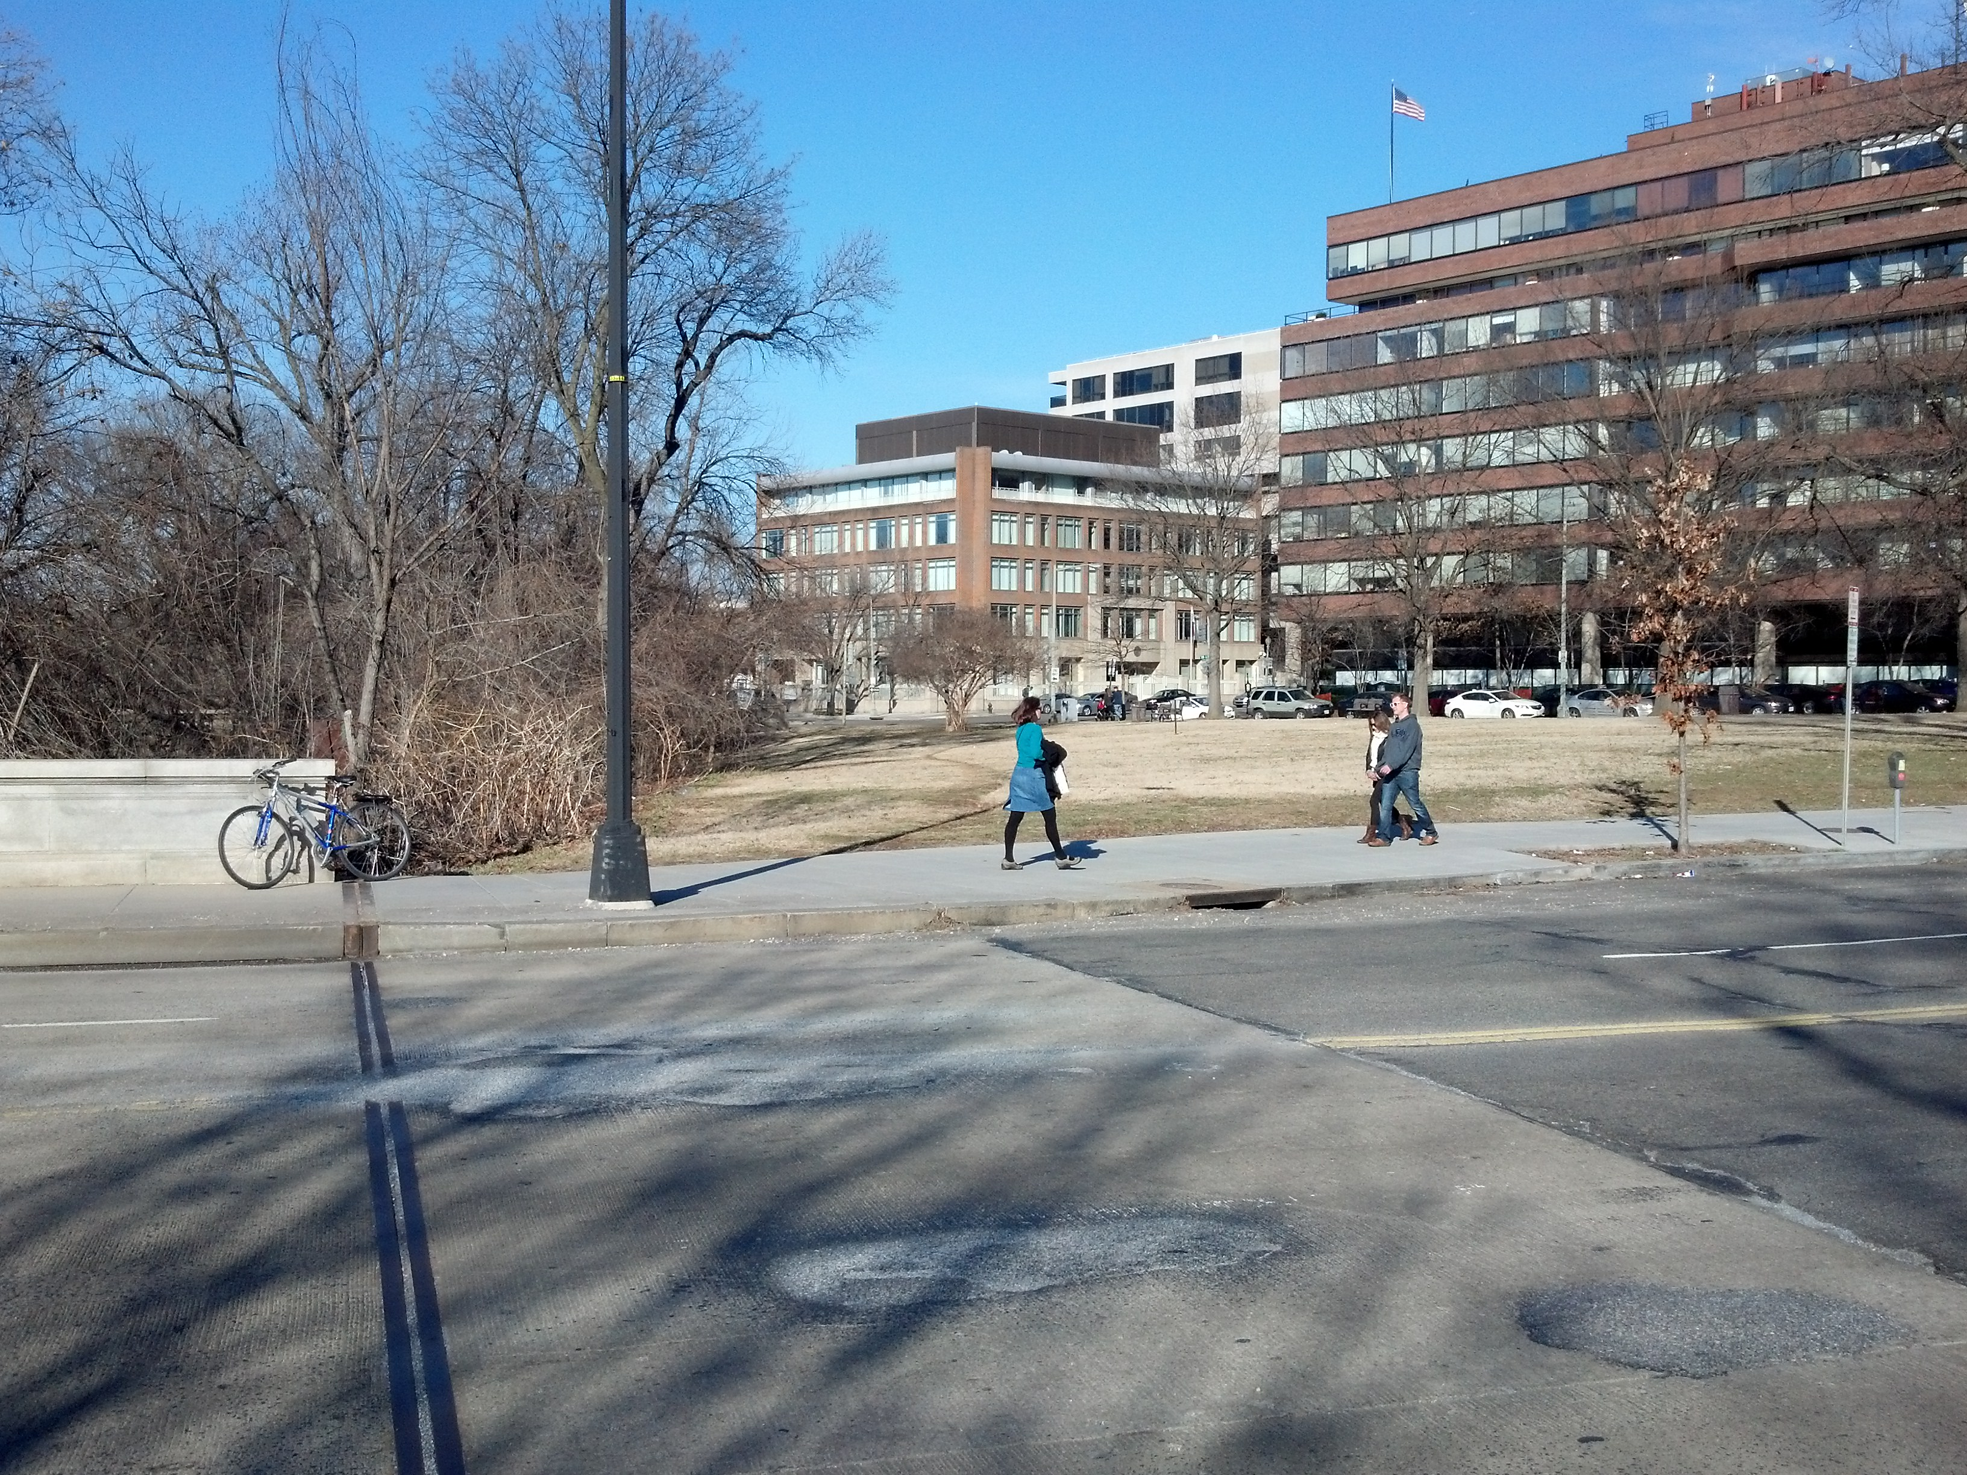
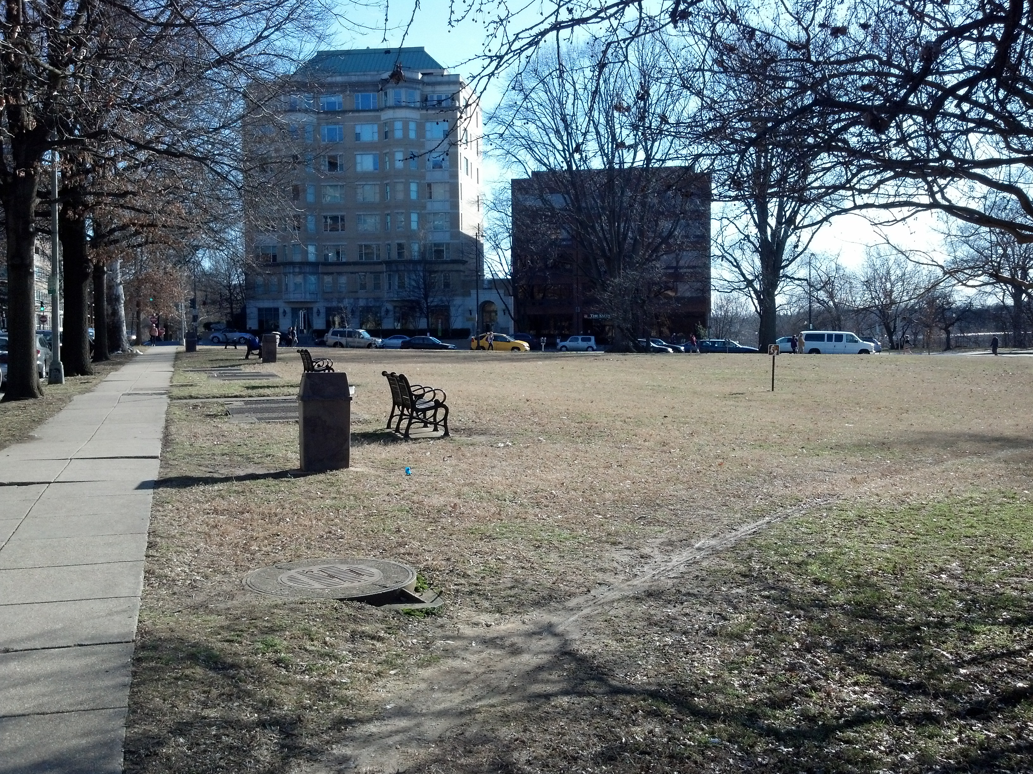
NCPC Site 46 – bounded by Rock Creek Park, Pennsylvania Avenue, 26th & M Streets, NW

Slide 10
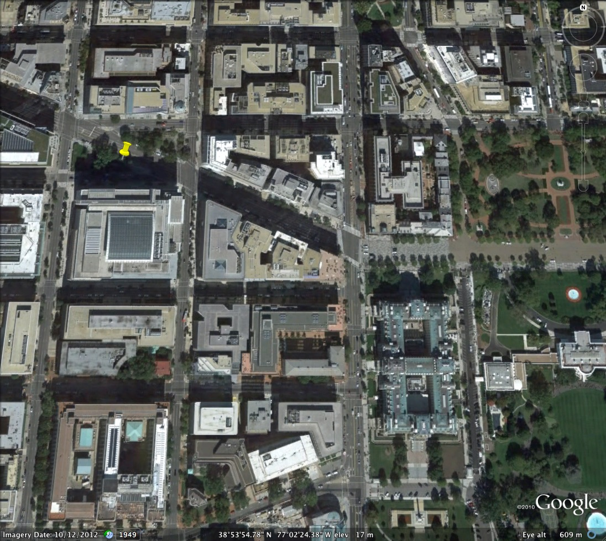
NCPC Site 44 – two triangles flanking and bounded by Pennsylvania Avenue between H, 18th & 19th Streets, NW, north of the The World Bank

Slide 11
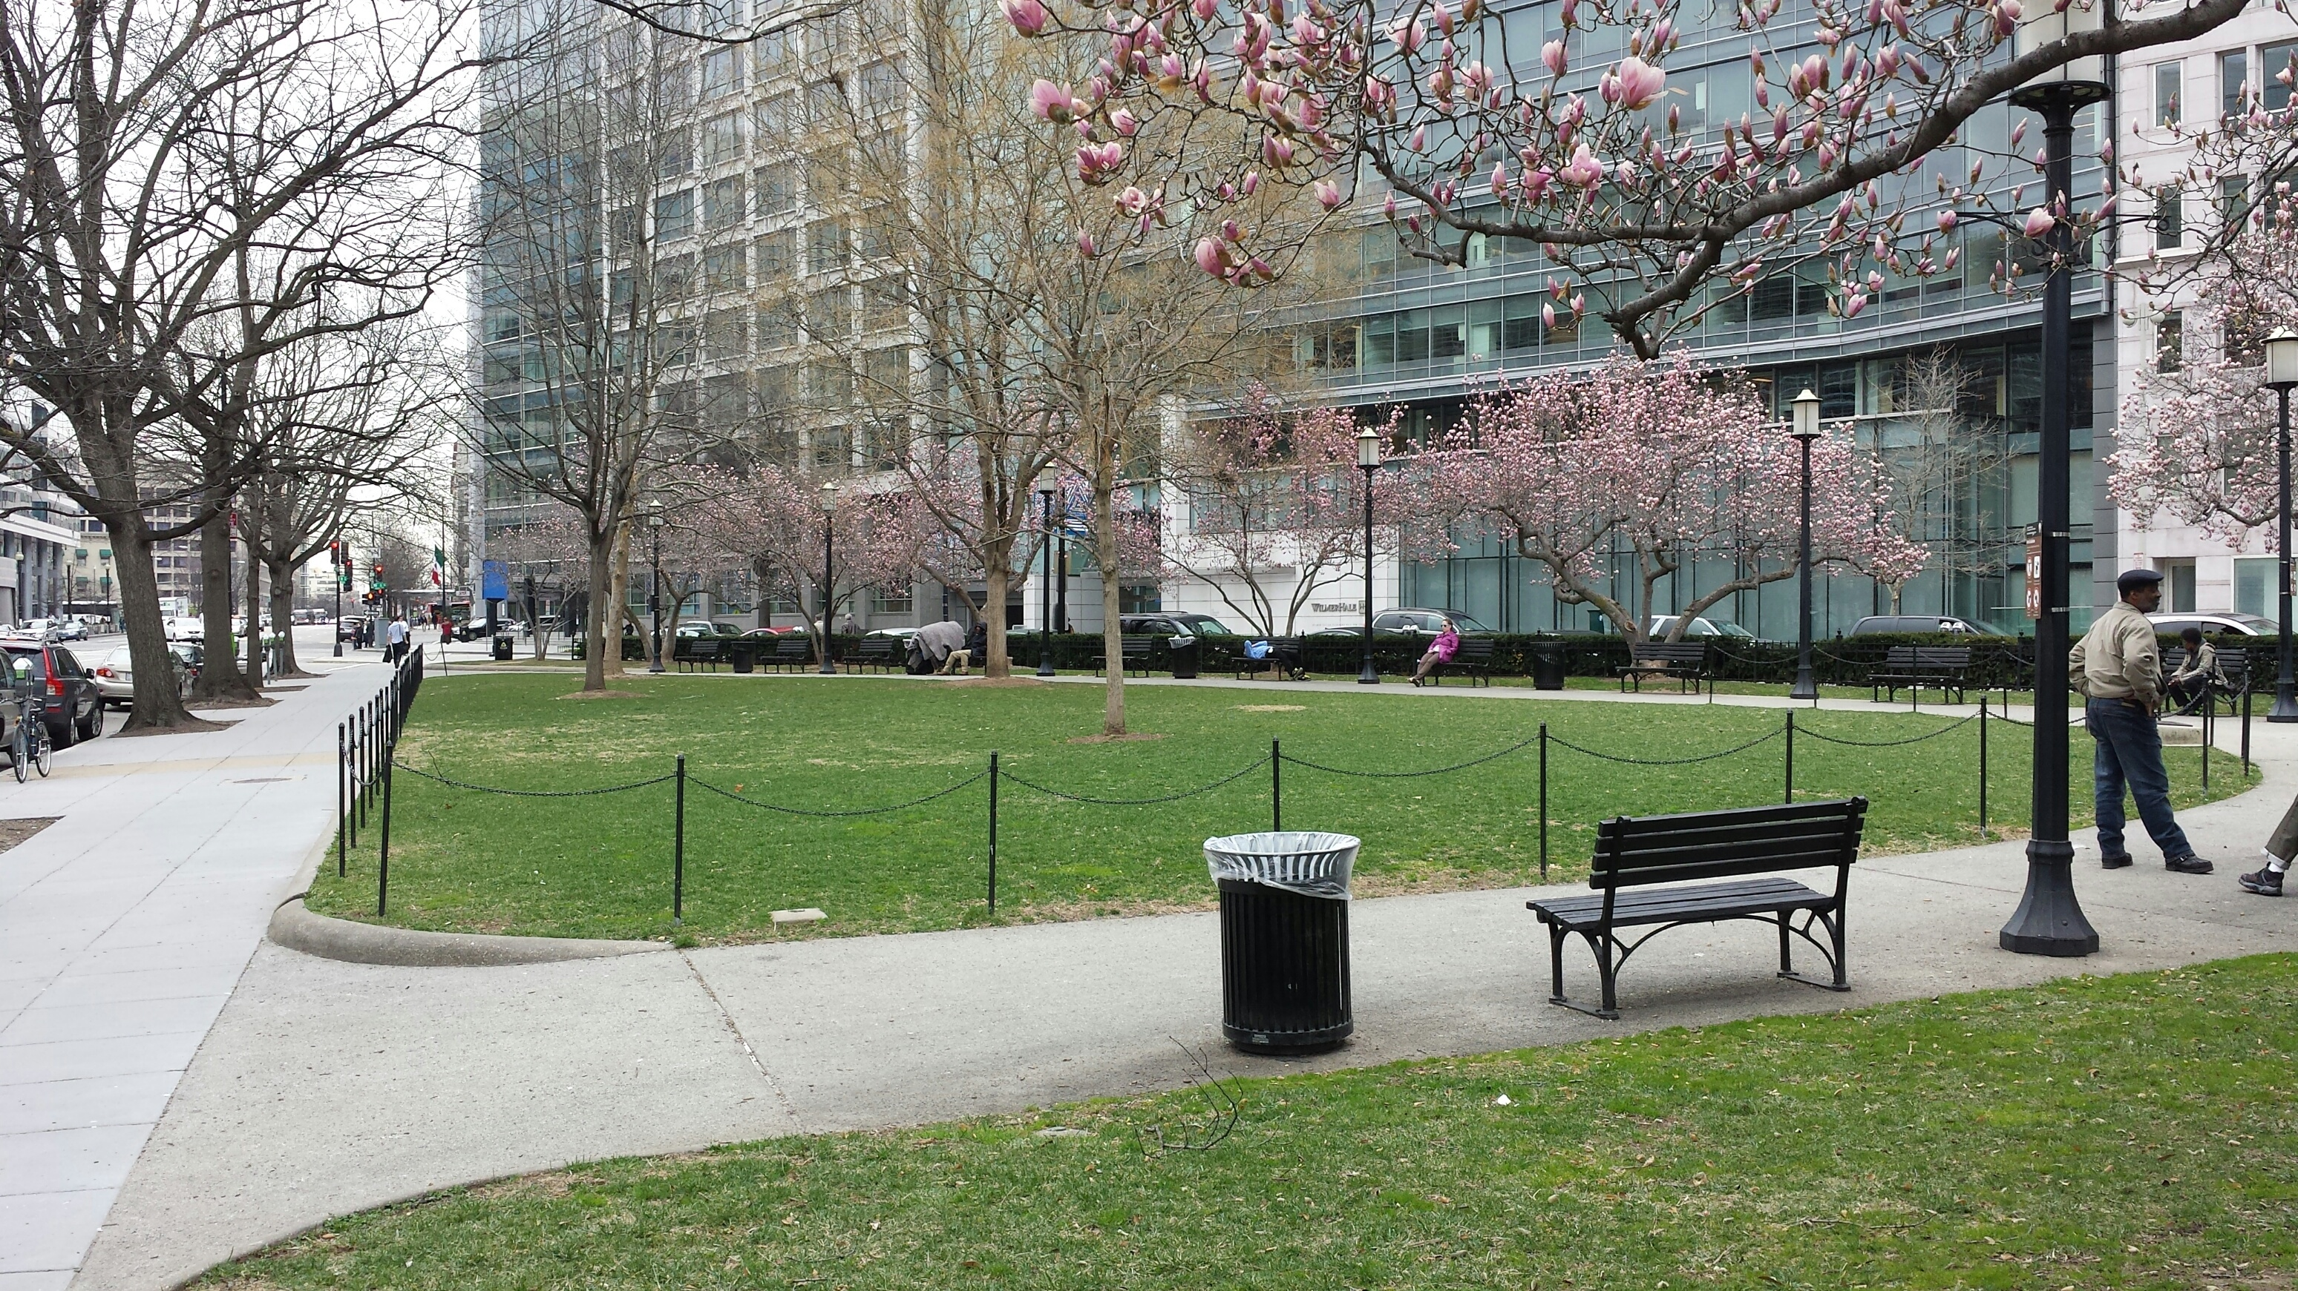
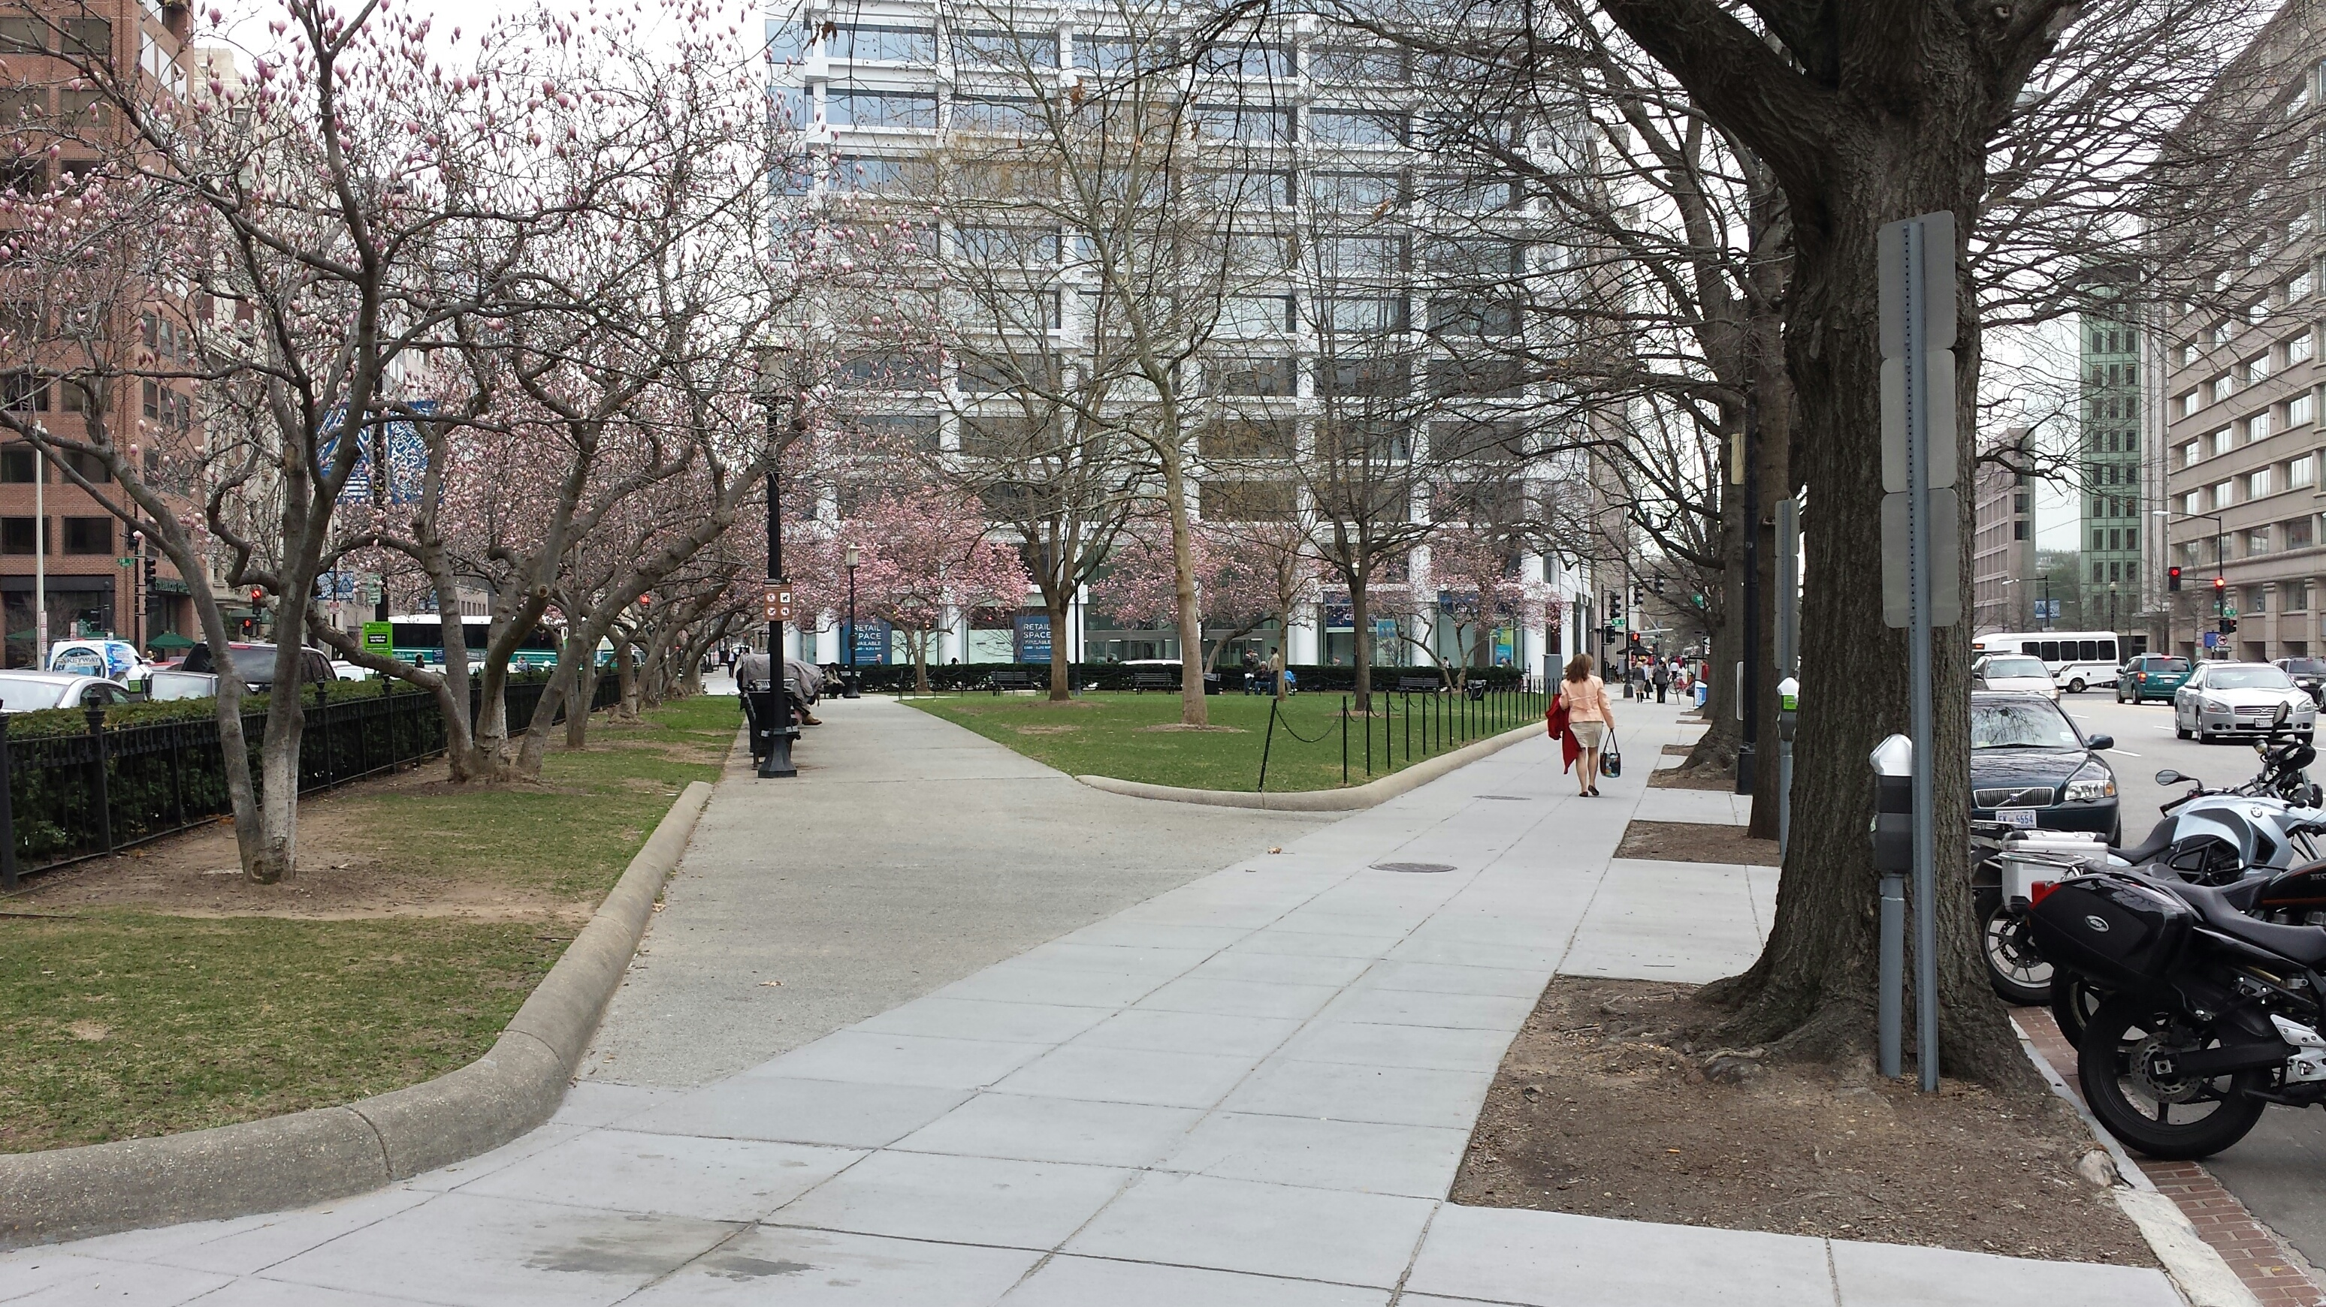
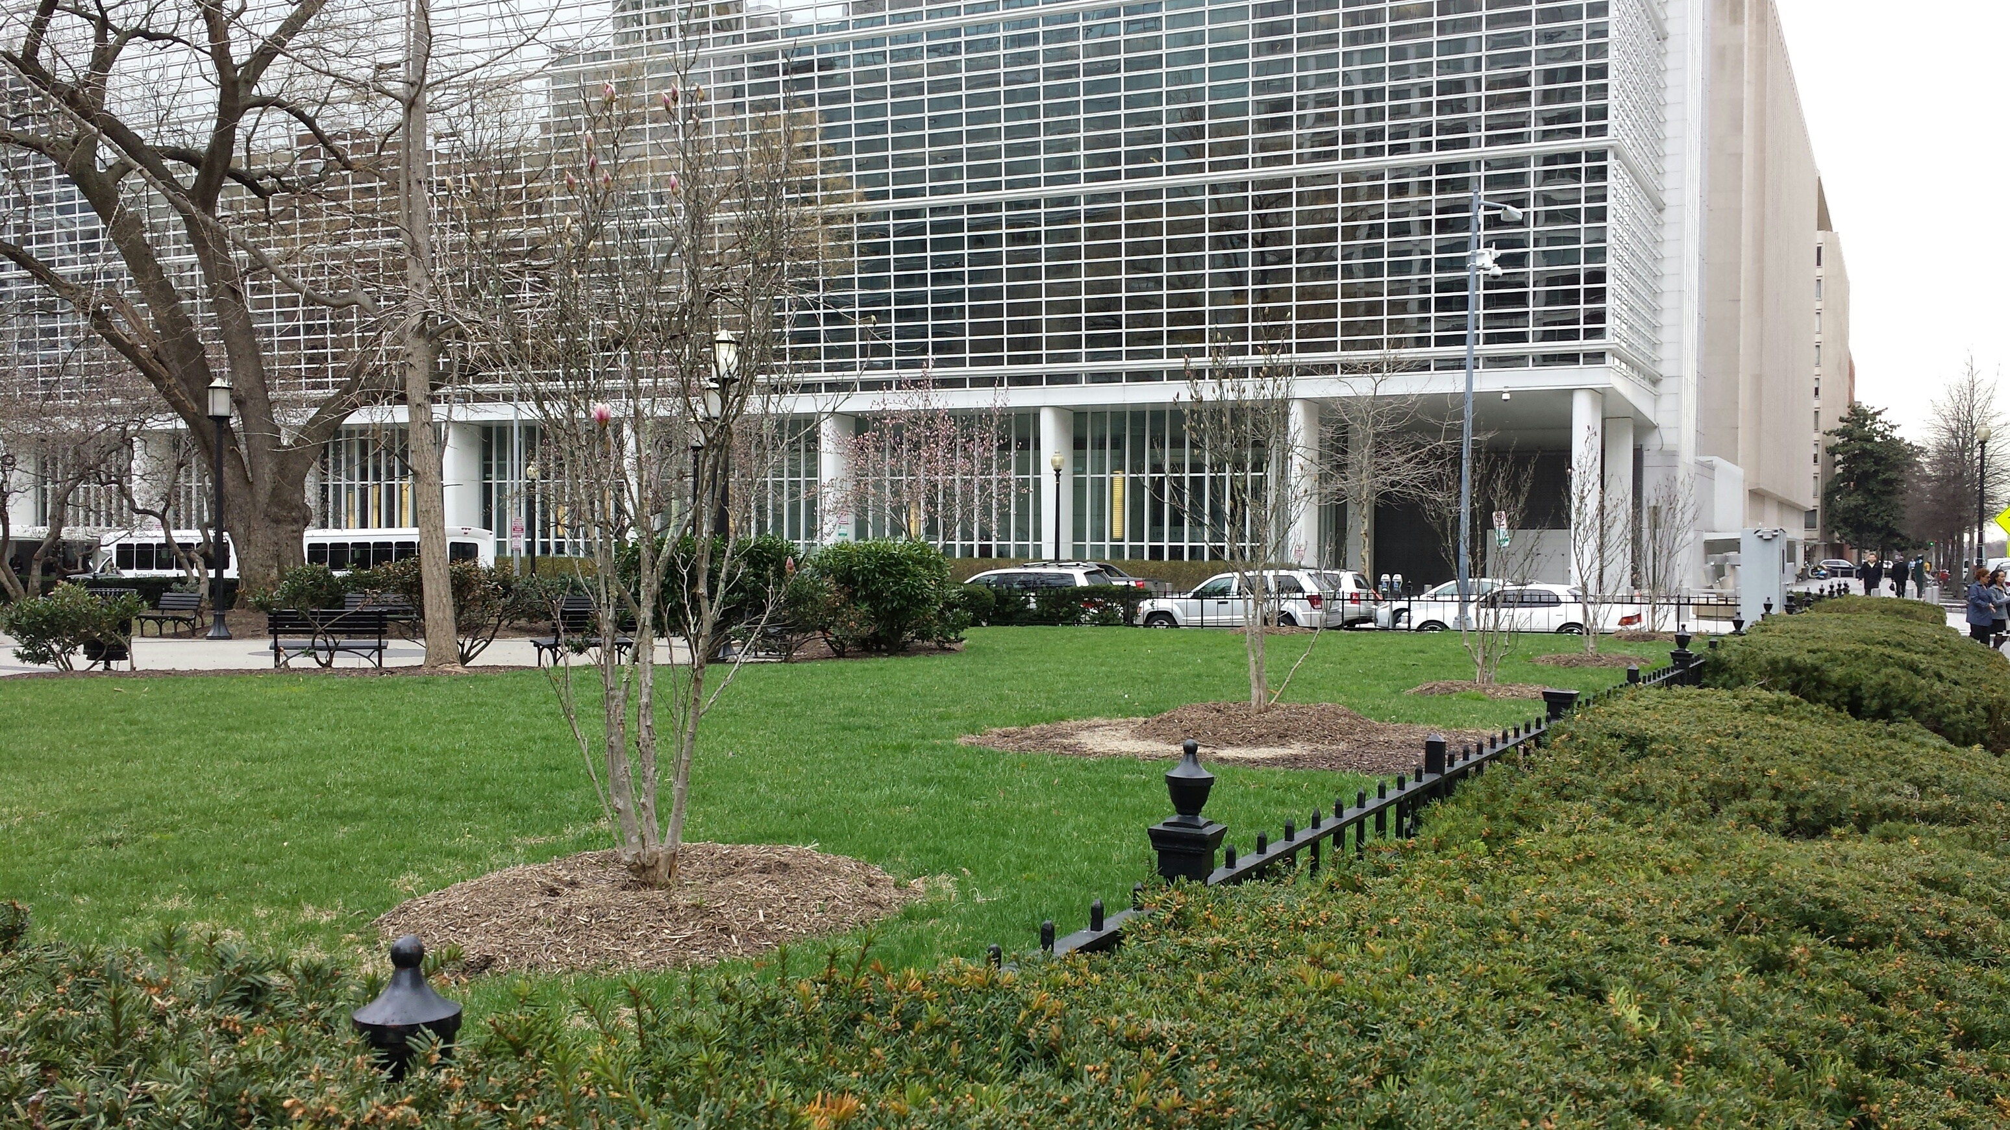
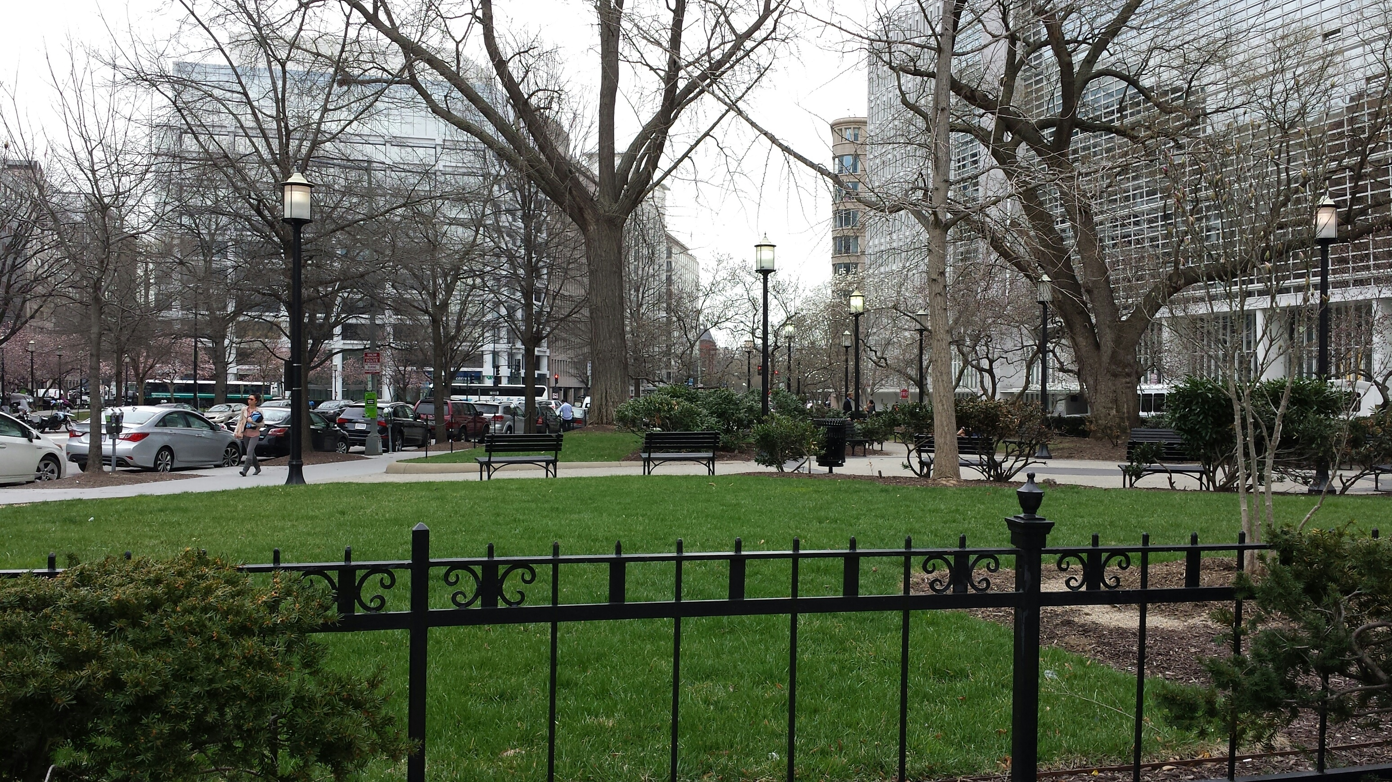
NCPC Site 44 straddling Pennsylvania Avenue between H, 18th & 19th Streets, NW

Slide 12
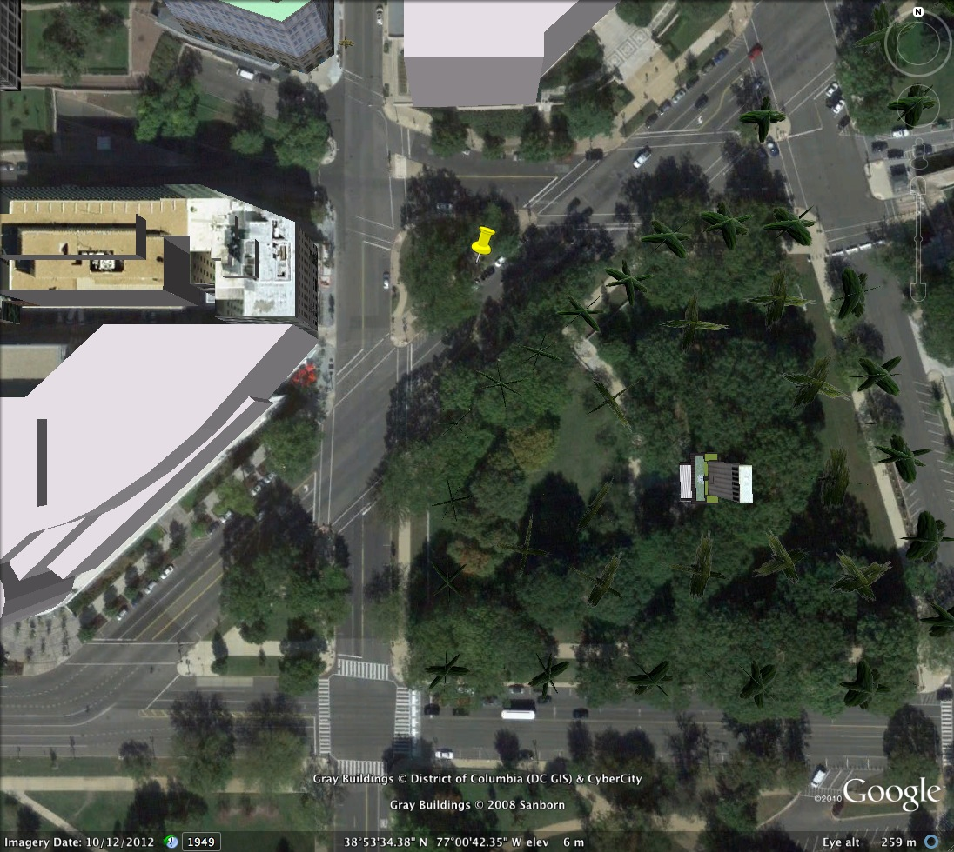
NCPC Site 25 – bounded by Louisiana Avenue, 1st and C Streets, NW

Slide 13
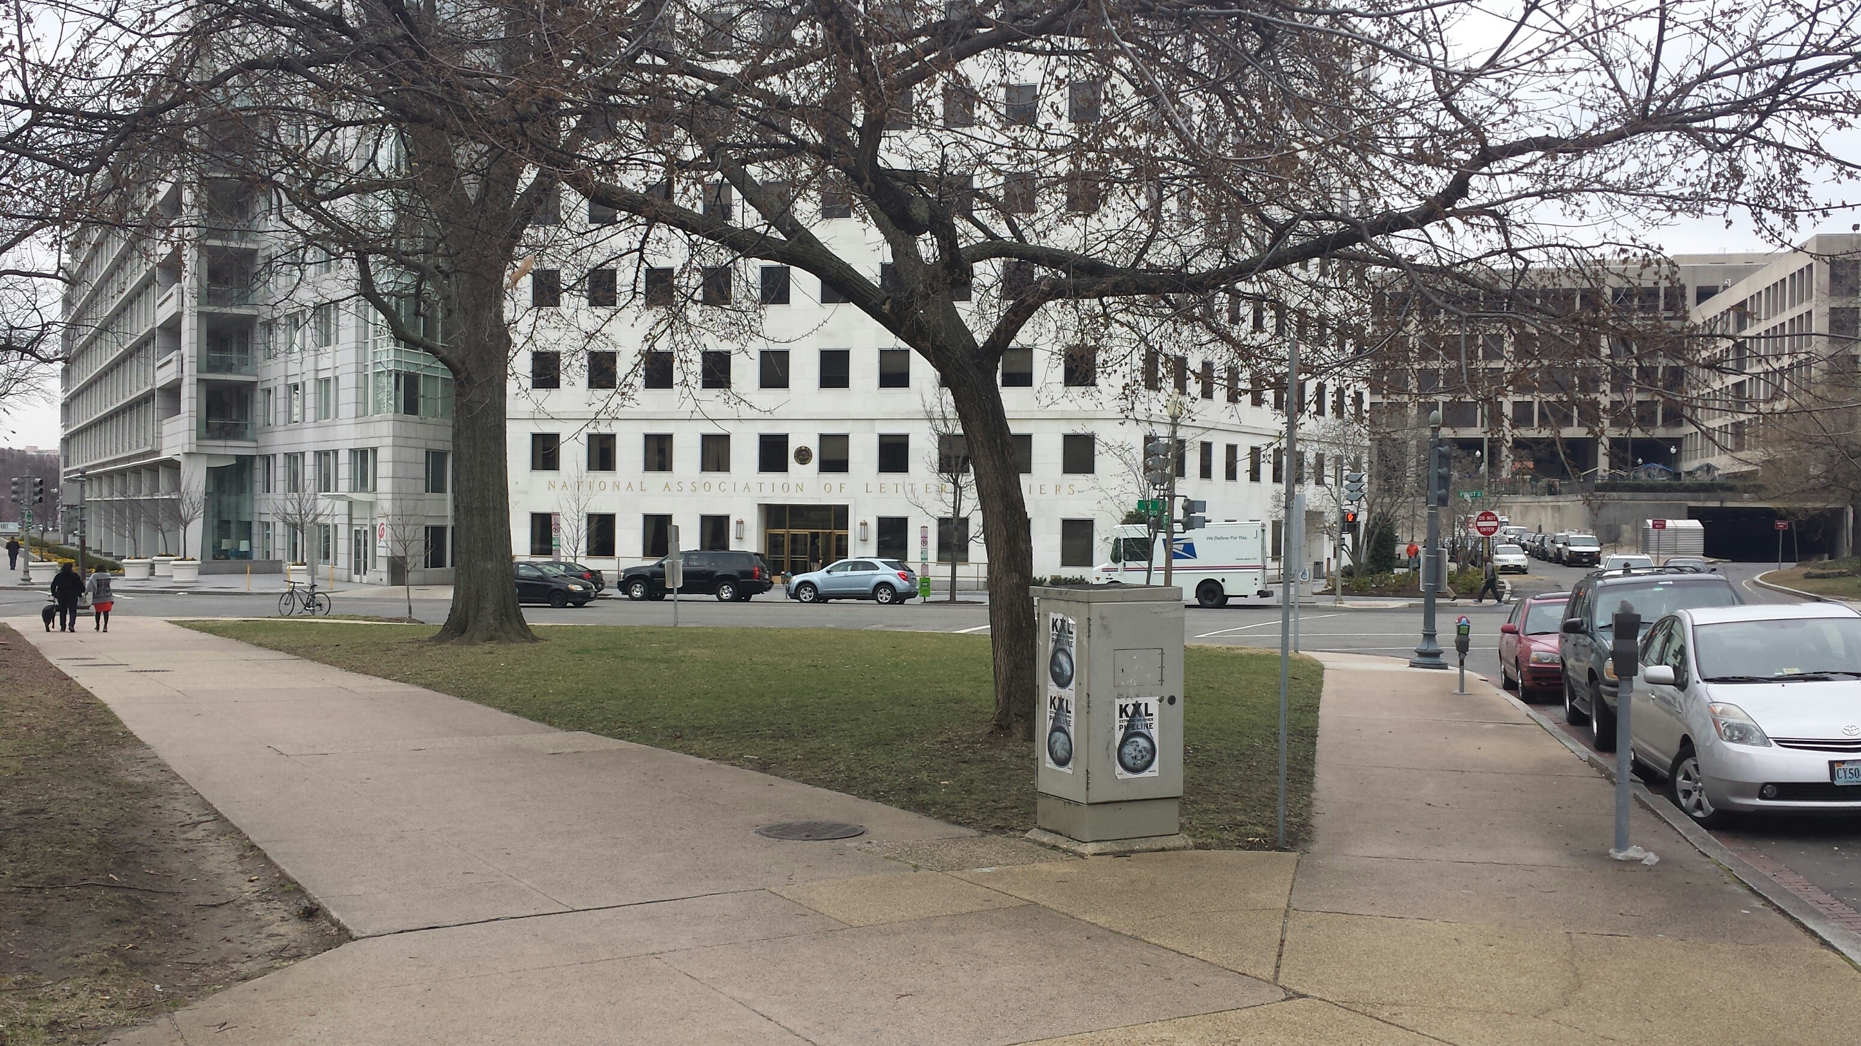
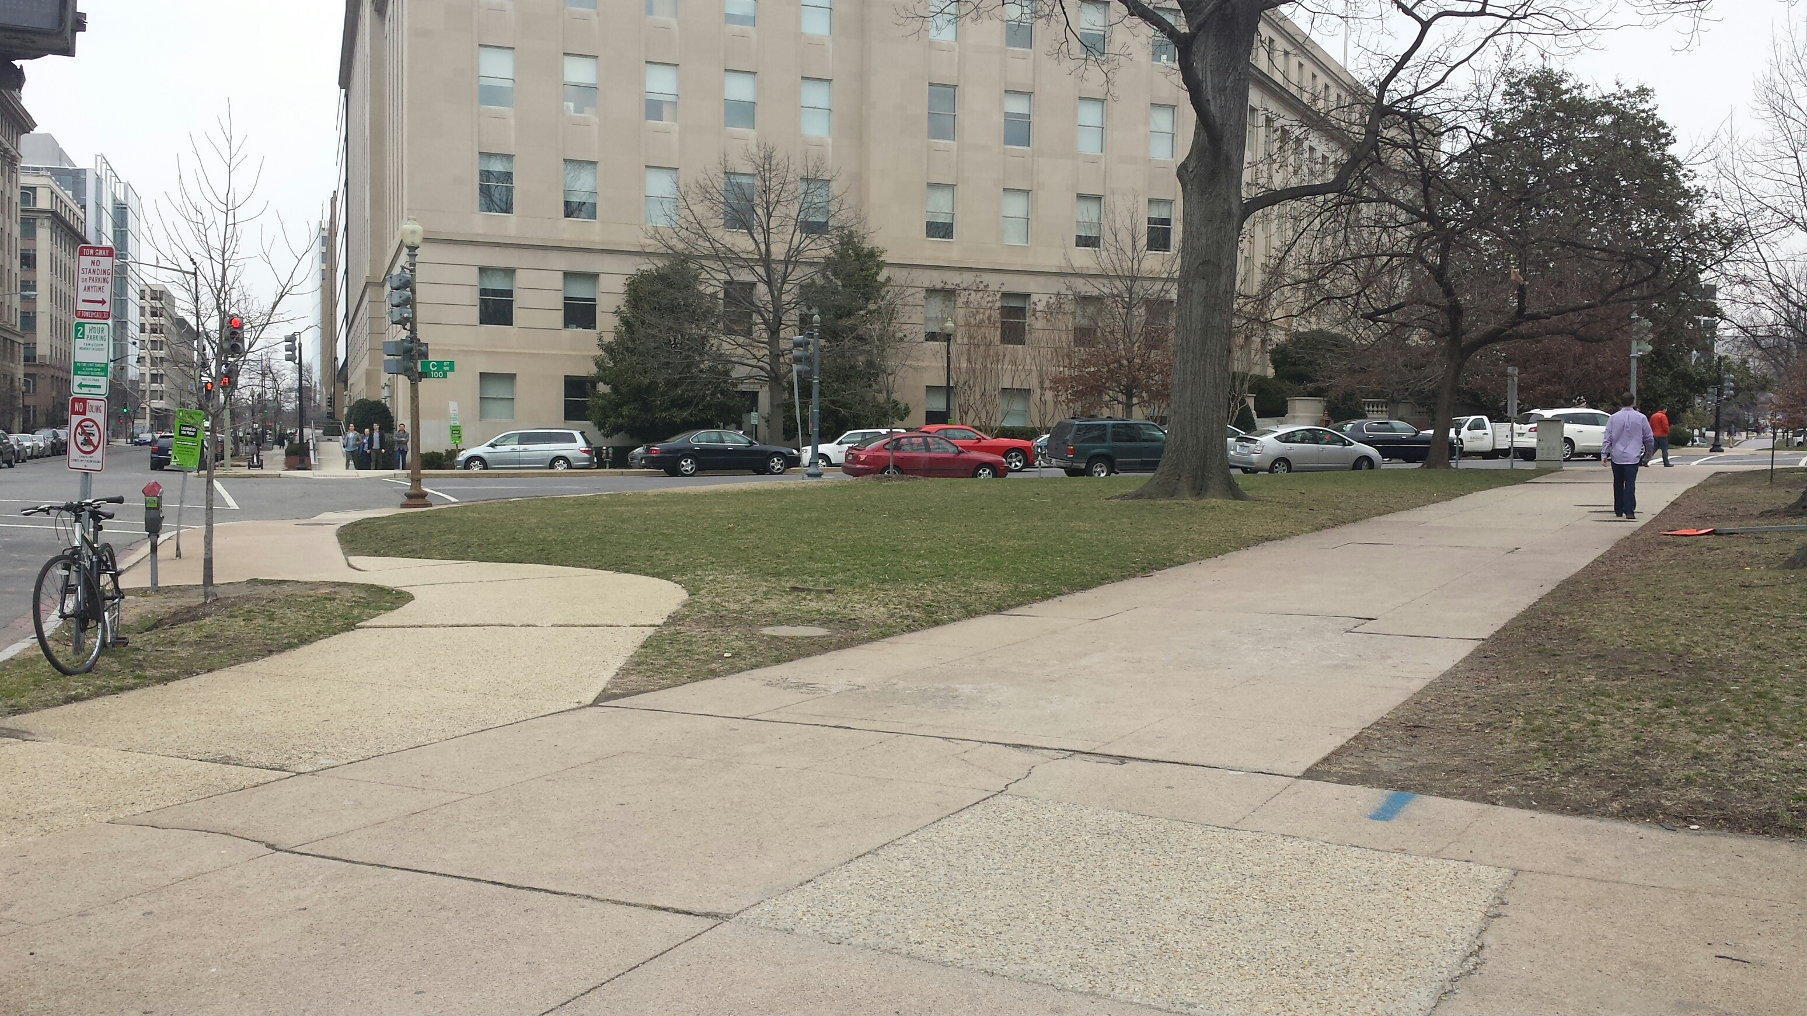
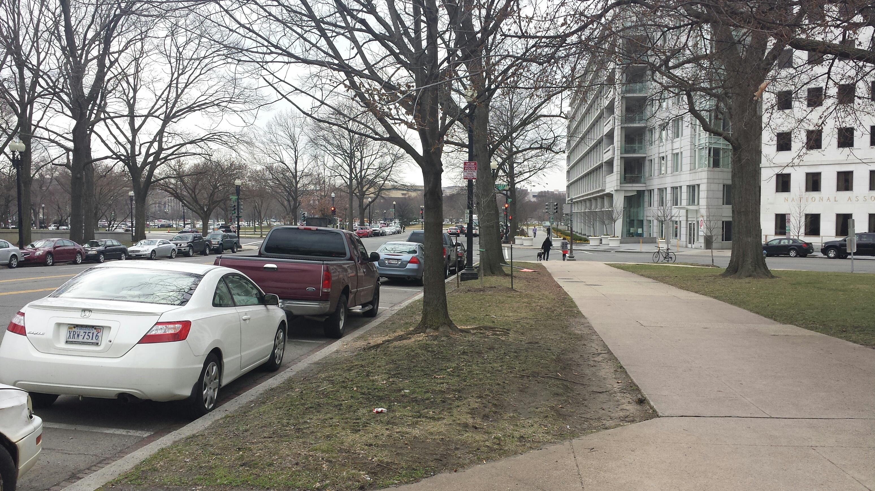
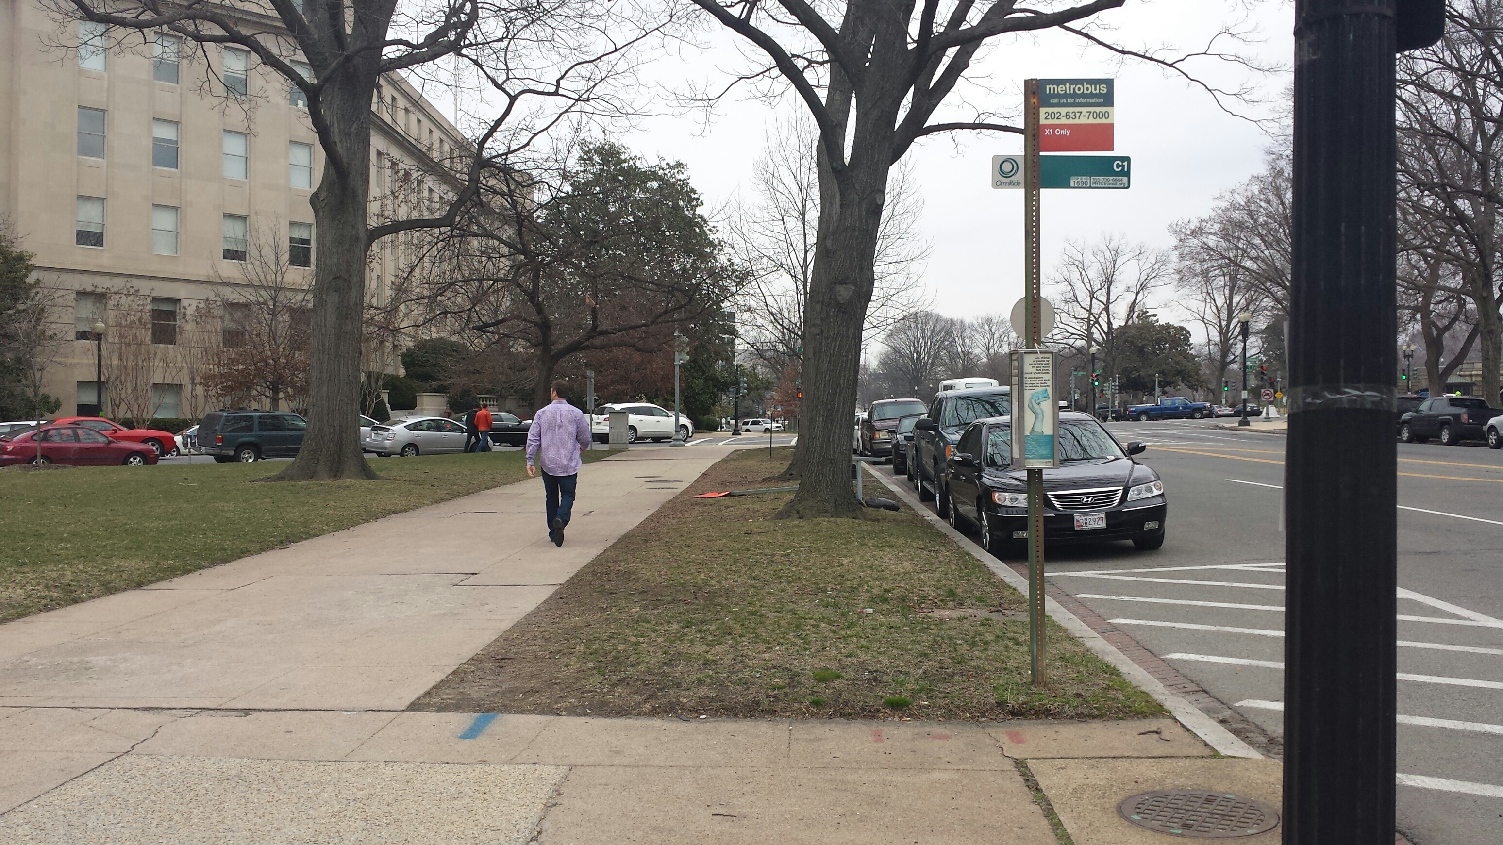
NCPC Site 25 – bounded by Louisiana Avenue, 1st and C Streets, NW

Slide 14
Tabulated below are weighted evaluations of the sites shown in the previous slides, rated 1 to 5, from very undesirable to very desirable. Site 25, although modest in size, is by far the most highly rated. Despite its distance from most memorials in the Monumental Core, its proximity to the Capitol and the National Mall can compensate for its remoteness from other memorials. And an exceptional design, to be procured through a national competition, will further compensate for the Commemorative’s limited size and location.
Site | Location In DC | Size (ac) | A Proximity To Monumental Core x 8 | B Public Visibility Pedestrian Access x 6 | C Nexus With Nearby Sites x 6 | D Views From Site x 5 | E Transit Access x 5 | F Public Parking Access x 2 | G Favorable Geometry & Topog’y x 2 | H Minimal Trees Structure Paving x 2 | WEIGHTED OVERALL SITE RATING Weighting x factor
25 | Louisiana Avenue, 1st & C St. NW | .25 | 4 32 | 4 24 | 4 24 | 5 25 | 4 20 | 4 8 | 5 10 | 5 10 | 153
44-1 East | Penn. Ave. 18th & H St. NW (Murrow Park) | .33 | 2 16 | 4 24 | 1 6 | 3 15 | 4 20 | 4 8 | 5 10 | 2 4 | 103
44-1 West | Penn. Ave. 19th & H St. NW | .33 | 2 16 | 4 24 | 1 6 | 3 15 | 4 20 | 4 8 | 5 10 | 1 2 | 101
46-1 East | Penn. Ave. 26th & M St. NW (RC Park) | 1.0 | 1 8 | 3 18 | 1 6 | 2 10 | 1 5 | 2 4 | 5 10 | 5 10 | 71

Slide 15
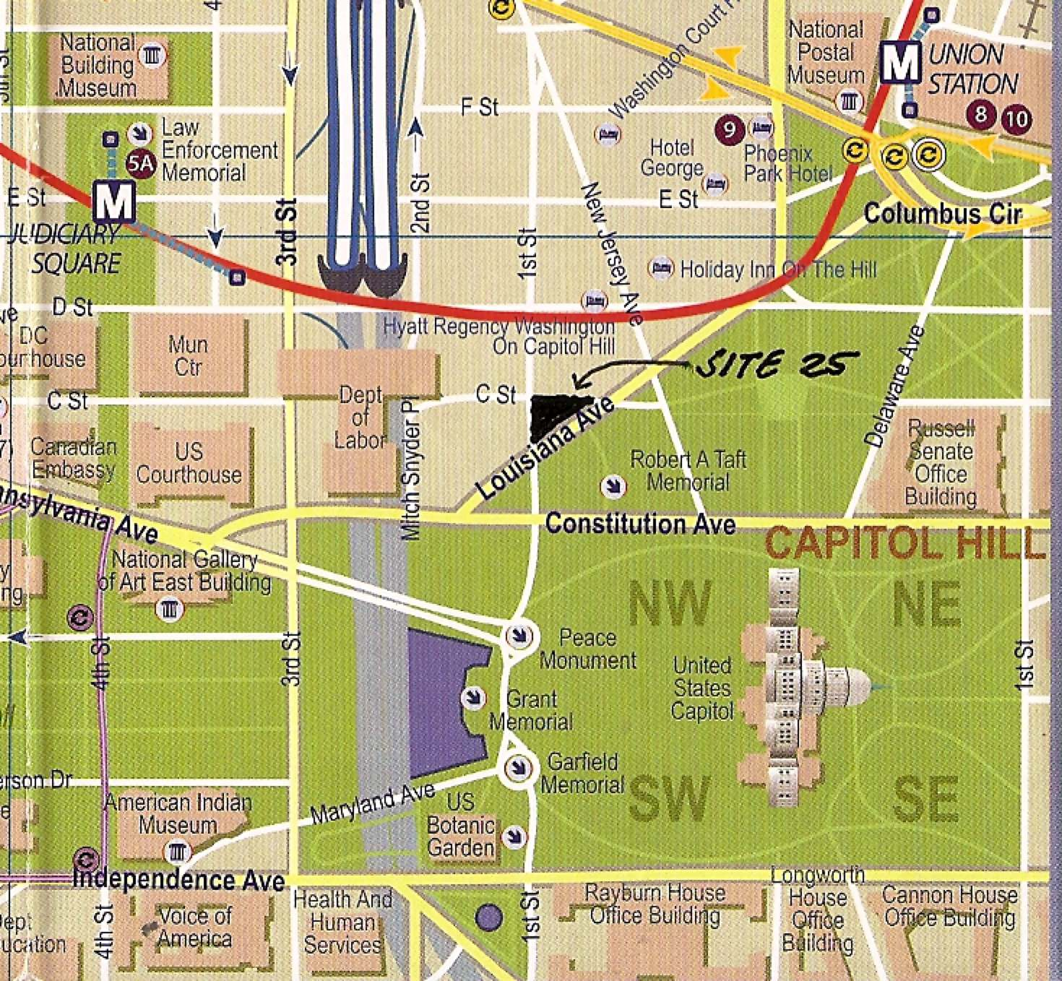
The map below shows the favorable relationship of Site 25 to the Monumental Core encompassing the Mall and its museums; the U.S. Capitol Grounds; the Peace Monument and Taft, Grant and Garfield Memorials; and the U.S. Botanic Garden. Also nearby are Union Station, two Metro stations, the National Postal Museum, the National Building Museum, Judiciary Square, and several high-quality hotels.

