Slide 1

World War II Women’s Memorial Location Act
(H.R.2290/S.1088)
National Capital Memorial Advisory Commission (NCMAC)
May 12, 2025

Slide 2
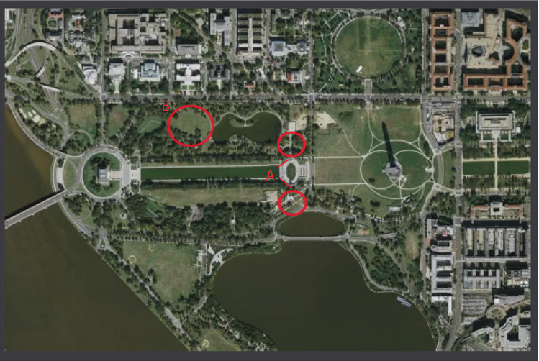
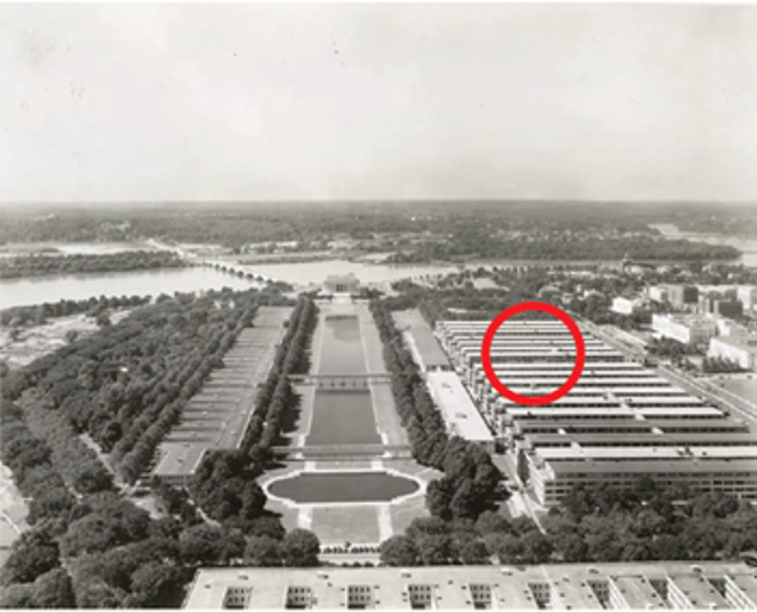
Sites with Strongest Nexus
A. Adjacent to the WWII
Memorial
B. Constitution Gardens
Civilian women worked in the temporary munitions and Navy buildings during WWII. Walkable to the WWII Memorial.

Slide 3
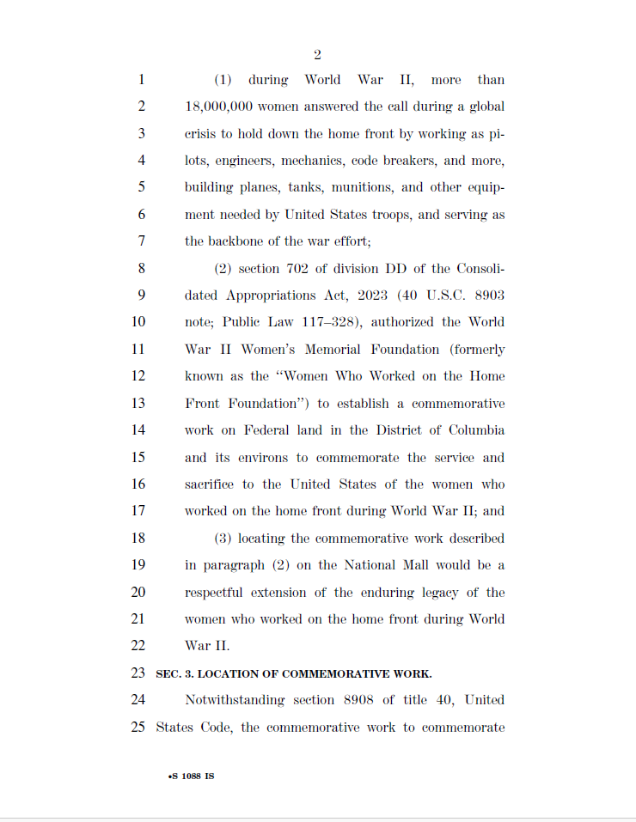
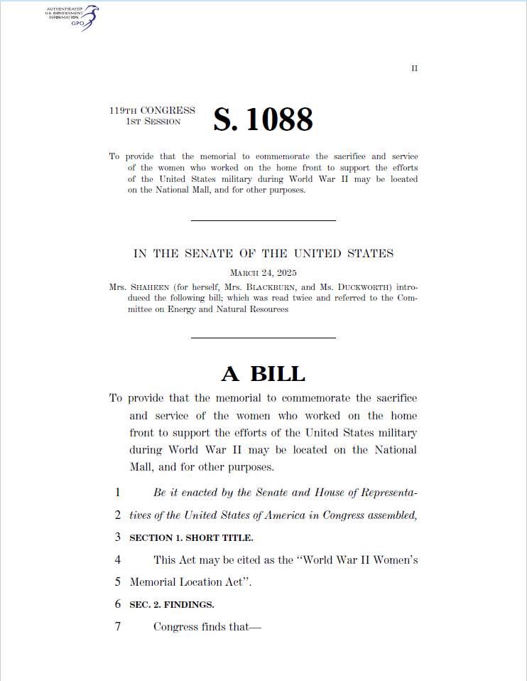
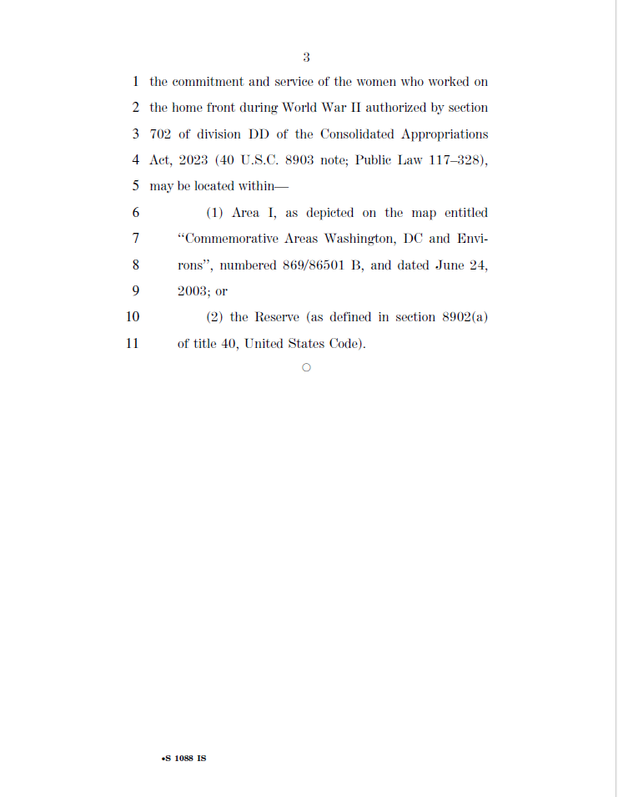
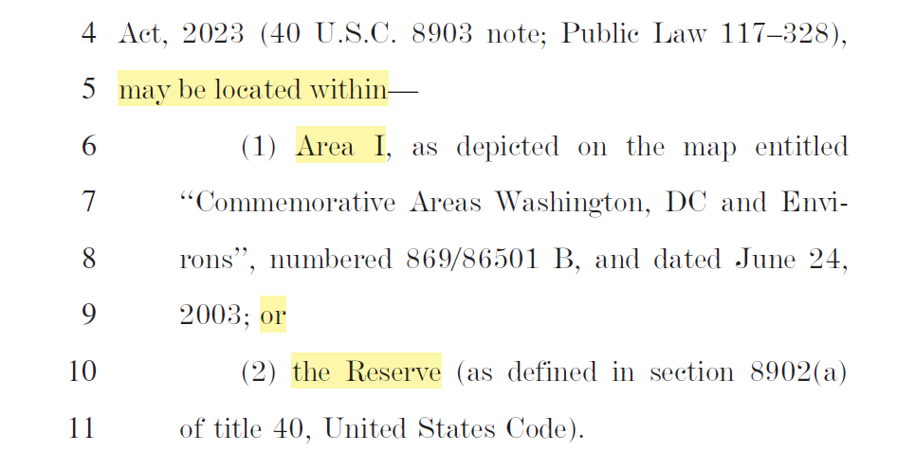
Bill Text

Slide 4
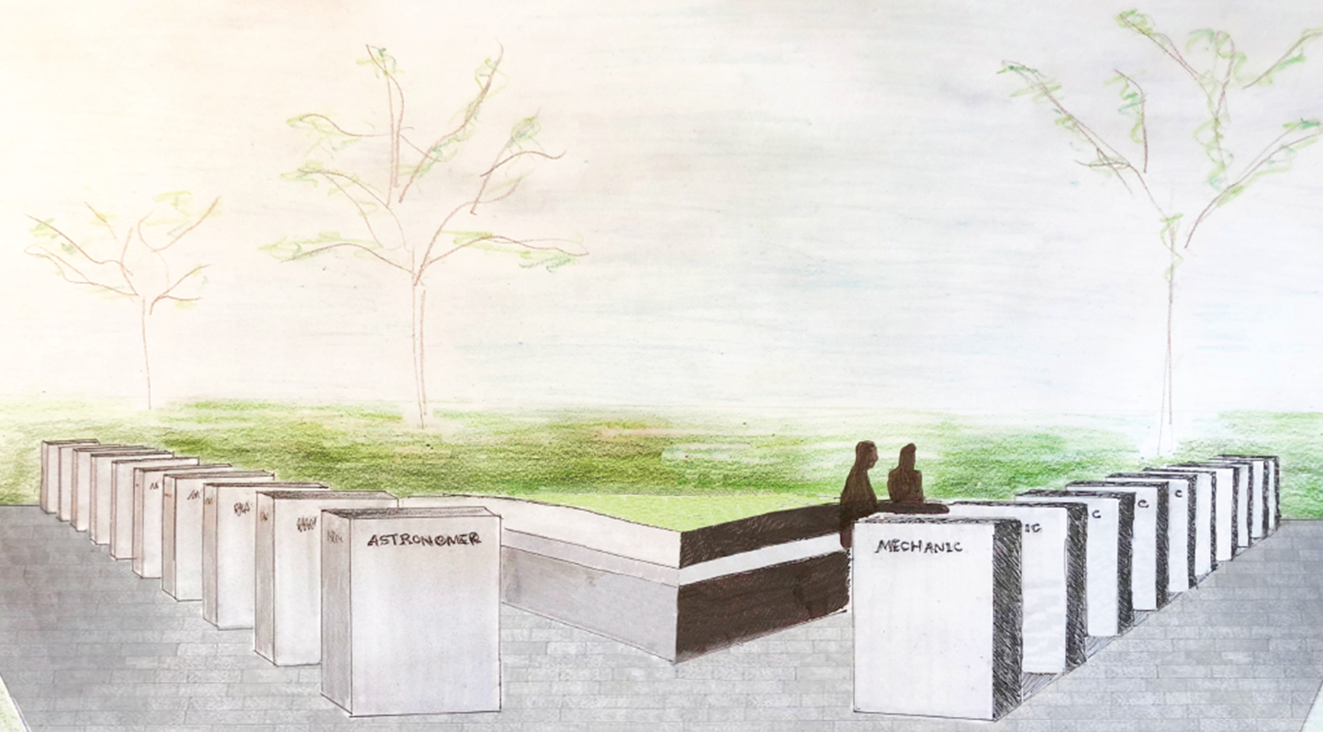
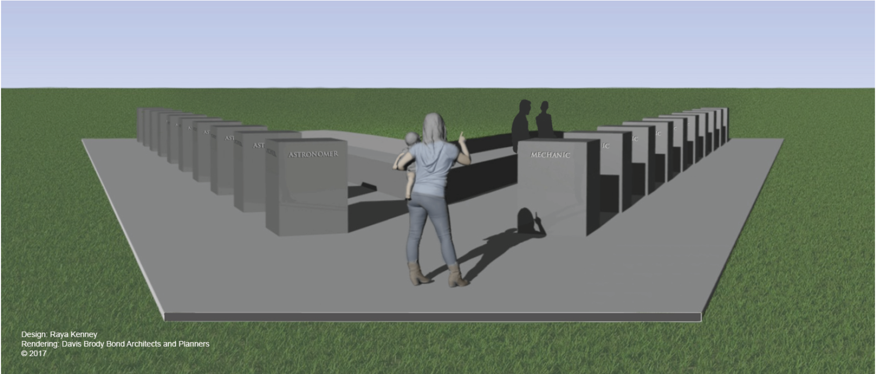
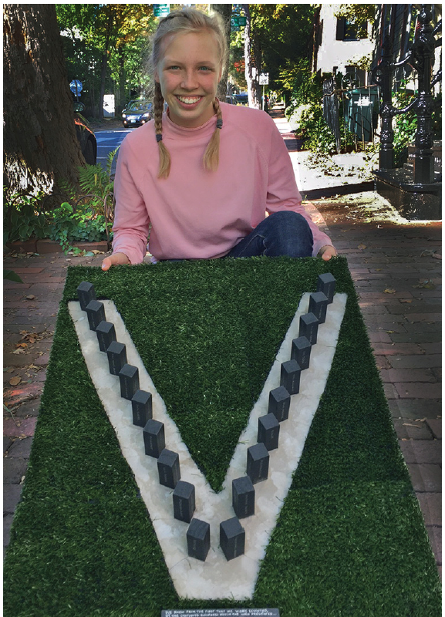
“V” for Victory

